Slide 1
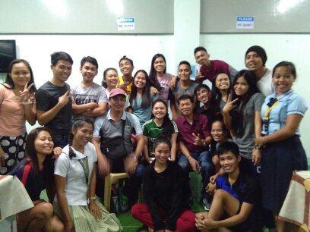
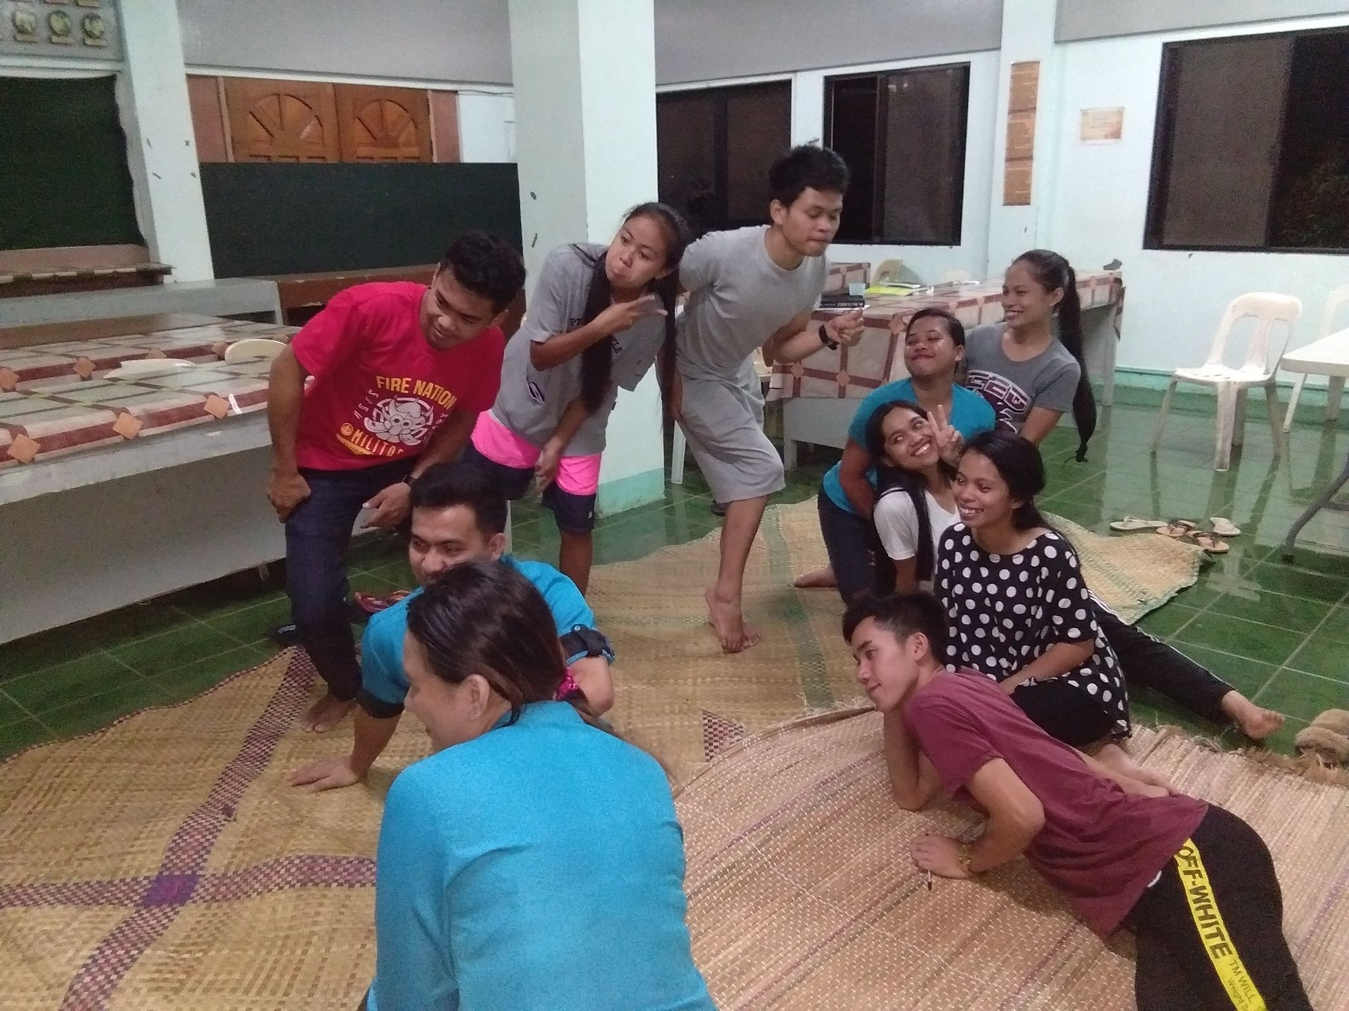
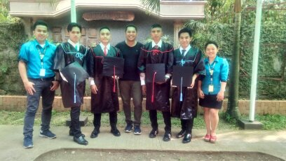
Educational Development Program (1993-2020)

Slide 2
EDUCATIONAL DEVELOPMENT PROGRAM (EDP)
Existing Projects
College Degree Scholarship Project (CDSP)
Senior High School - Collegiate Educational Assistance Project (SHP-CEAP)
Earlier Projects
Technical/Vocational Scholarship Project (TVSP)
Teachers-to-the-Barangay Project (TBP)
Law Scholarship Grant Project (LSGP)
Master in Education Scholarship Project (MESP)
High School Student Assistance Project (HSSAP)

Slide 3
OVERALL STATISTICAL RECORD/NUMBER : EDP SCHOLARSHIP (1993-2020)
GRANTEES’ ETHNICITY
TOTAL IP GRANTEES: 349 or (81.16%)
TOTAL NON-IP GRANTEES: 81 or (18.84%)
IP
NON IP
Notes:
Overall, MAFI has supported a total of 430 scholars in various scholarship categories/projects from 1993 up to 2020.
Of the total grantees over the same period, 320 scholars or 78% have graduated or completed their courses, while a significant number (91 scholars) or 22% have failed to continue or finish their studies. Nineteen of these scholars are currently enrolled and are continuing their college scholarships.
In terms of their ethnicity, 349 or 81% of the grantees are Indigenous People, while the remaining 81 or 19% are non-IP’s.
By AOR, Kidapawan has the most number of scholarship grantees (199), followed by Magpet (131), and Makilala (99). While Davao is outside of MAFI’s AOR, the foundation has exceptionally supported one (1) college scholar from this area due to transfer of residency of the family.

Slide 4
COLLEGE DEGREE SCHOLARSHIP PROJECT (CDSP) – 1993-2020
CDSP GRANTEES BY PERCENTAGE AND BY MUNICIPALITY
MAFI AOR
GRANTEES
TERMINATED
GRADUATES
EXISTING
DAVAO AREA
DAVAO AREA
1
0
1
0
0.4%
KIDAPAWAN CITY
44.9%
133
33
91
CDSP
KIDAPAWAN CITY
9
MAGPET
32.1%
MAGPET
95
23
69
3
MAKILALA
22.6%
MAKILALA
67
14
46
7
TOTAL
296
70
207
19
%
100%
23.6%
70%
6.4%
Ref. Data: As of 2020
Notes:
By scholarship category, MAFI has supported a total of 296 scholars in College.
Of this number, 207 or 70% have graduated, while a significant number (70) or 23.6% failed to continue or dropped their college scholarship due to various reasons.
Nine-teen or 6.4% of them are existing college scholars.
In terms of ethnicity, 81% of the college grantees are IP’s while 19% are non-IP’s.
In terms of AOR, many of the college scholars (45%) come from Kidapawan; 32% are from Magpet, while the rest (22.6%) come from Makilala.

Slide 5
SENIOR HIGH SCHOOL – COLLEGIATE EDUCATIONAL ASSISTANCE PROJECT (SHS-CEAP) – (2 Year SHS - 2017-2019)
MAFI AOR
GRANTEES
GRADUATED
EXISTING
SHS-CEAP GRANTEES BY PERCENTAGE AND BY MUNICIPALITY
KIDAPAWAN CITY
6
6
0
KIDAPAWAN CITY
40%
SHS-CEAP
MAGPET
3
3
0
MAGPET
20%
MAKILALA
MAKILALA
6
6
0
40%
15 Scholars under the SHS-CEAP moved up to college and currently under the CDSP
TOTAL
15
15
0
%
100%
0%
Ref. Data: As of 2020
Notes:
Beginning school year 2017, MAFI embarked on Senior High School Scholarship Program (Grades 11 and 12) to properly prepare the scholars towards collegiate education through the appropriate tracks and strands that fit their aptitude, interest and intelligence.
All 15 intake (100%) of SHS grantees in 2017 have successfully graduated in 2019.
Of this number, 73% of SHS scholars are IP’s, while 27% are non-IP’s.
By AOR, Kidapawan and Makilala have 40% each of the scholars coming from these areas, while the remaining 20% come from Magpet.

Slide 6
TECHNICAL/VOCATIONAL SCHOLARSHIP PROJECT (TVSP)
TVSP GRANTEES BY PERCENTAGE AND BY MUNICIPALITY
MAFI AOR
GRANTEES
TERMINATED
GRADUATES
EXISTING
KIDAPAWAN CITY
53%
KIDAPAWAN CITY
55
7
48
0
TVSP
MAGPET
26%
MAGPET
27
2
25
0
MAKILALA
21%
MAKILALA
22
5
17
0
TOTAL
104
14
90
0
%
13.5%
86.5%
0%
Ref. Data: As of 2015
Notes:
In terms of the Technical/Vocational Scholarship Project in early years, MAFI has supported a total of 104 scholars; of which, 90 or 86.5% have graduated from their tech/voc education, while 14 scholars or 13.5% have failed to complete their tech/voc courses due to varying reasons.
In terms of ethnicity, 80% of the TVSP grantees are IP’s, while 20% are non-IP’s.
By AOR, more than half (53%) of the scholars come from Kidapawan City, followed by Magpet (26%) and Makilala (21%).

Slide 7
TEACHER-TO-THE-BARANGAY PROJECT (TBP)
KIDAPAWAN CITY
Elementary – 5 Volunteers
High School - 6 Volunteers
MAGPET
TOTAL
Elementary – 14 Volunteers
High School - 0
29 Volunteers
MAKILALA
Elementary – 3 Volunteers
High School - 1 Volunteer
Ref. Data: As of 2013
Notes:
MAFI also embarked in 2013 Teacher-to-the-Barangay Project. There were 29 volunteer-teachers who taught in various elementary schools and high school level in Kidapawan, Magpet and Makilala with the most number of volunteerteachers assigned in Magpet elementary schools.

Slide 8
LAW SCHOLARSHIP GRANT (LSGP)
MAFI AOR
GRANTEES
FAILED TO CONTINUE
GRADUATES
EXISTING
KIDAPAWAN CITY
2
2
0
0
MAGPET
0
0
0
0
MAKILALA
2
0
2
0
TOTAL
4
2
2
0
%
100%
50%
50%
0%
Ref. Data: As of 2011
GRADUATES
PLACE OF ORIGIN
BANAAG, RALPH I.
OLD BULATUKAN, MAKILALA, COTABATO
PAZ, IVY ROSE B.
POBLACION, MAKILALA, COTABATO
Notes:
MAFI has also supported higher studies such as Law School, although on a limited scale, in 2011.
Of the four (4) scholars supported, 2 or 50% have successfully graduated, and one of them is now a lawyer. These grantees are both residents of Makilala in North Cotabato.

Slide 9
MASTER INEDUCATION SCHOLARSHIP PROJECT (MESP)
MAFI AOR
GRANTEES
FAILED TO CONTINUE
GRADUATES
EXISTING
KIDAPAWAN CITY
3
2
1
0
MAGPET
6
2
4
0
MAKILALA
2
1
1
0
TOTAL
11
5
6
0
%
100%
45.5%
54.5%
0%
Ref. Data: As of 2016
Notes:
MAFI has also embarked in providing support for Masters in Education, also on selective basis.
It has supported 11 grantees under the MESP; of this number, 54.5% have completed their Masters, while the rest (45.5%) have failed to finish their graduate studies.
By AOR, 50% of the grantees come from Magpet, while 25% each come from Kidapawan and Makilala, respectively.

Slide 10
HIGH SCHOOL STUDENT ASSISTANCE PROJECT (HSSAP)
Manobo HS
Manumba Memorial HS
Pangao-an HS
Batasan HS
Buenavida HS
Indangan HS
Malasila HS
Kisante HS
New Israel HS
Ricardo Ipong Memorial HS
Buhay HS
Garsika HS
Ginatilan HS
Juan Jalipa Memorial HS
Manongol HS
Mt. Apo HS
Perez HS
Lake Agco Integrated HS
Mua-an Integrated HS
Sumayahon Intefrated HS
MAGPET
(WITHIN AOR)
KIDAPAWAN CITY
3 High Schools
MAKILALA
(WITHIN AOR)
(WITHIN AOR)
9 High Schools
8 High Schools
Amas NHS
Kalaisan NHS
Spottswood HS
Saniel Cruz HS
B Orteza NHS
Cabilao HS
Luayon HS
Saguing HS
Sto. Niño HS
Alibayon HS
L. Romero Sr. HS (Binay)
Magpet NHS
DAVAO AREA
34 SCHOOLS BENEFECIARIES
OUTSIDE MAFI AOR
1. DIGOS CITY : Kapatagan HS
2. STA. CRUZ : Tudaya IP HS
(WITHIN AOR)
70, 098
2 High Schools
12
High Schools
Student Beneficiaries
Ref. Data: As of 2013
www.free-powerpoint-templates-design.com
Notes:
During early years, MAFI had also supported High School Students (before SHS) in both the 3 AOR and outside of MAFI’s AOR.
There were 34 schools which benefited from the High School Student Assistance Project of MAFI with a total student beneficiaries of some 70,098 spread within and outside the AOR.

